Slide 1

Half Year (January –June 2022)

Slide 2
FINANCIAL REVIEW
Income by Events for period January to June 2022
 |  |  |  |  |  | £
 |  | Subscription |  |  |  | 1440
 |  | T-Shirts Income |  |  |  | 90
 |  | Bereavement |  |  |  | 695
 |  | Donation -Ogunbiyi |  |  |  | 660

Slide 3
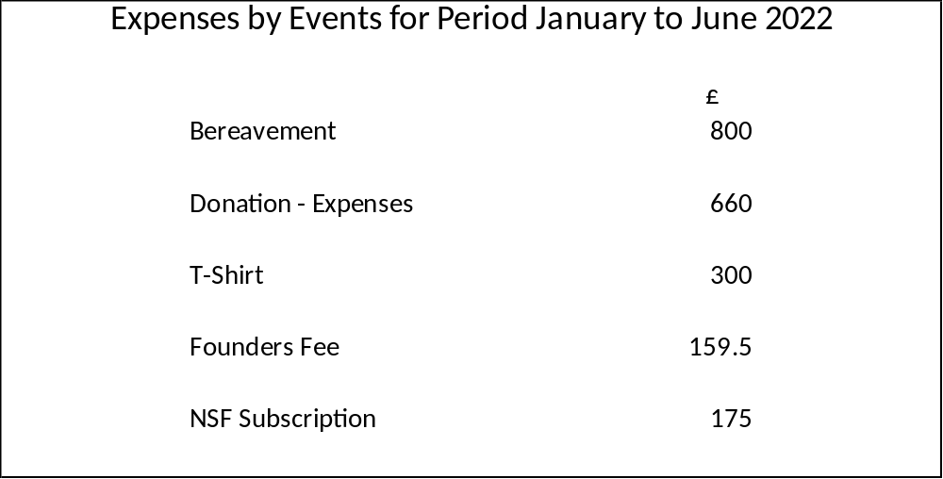
EXPENSES BY EVENTS

Slide 4

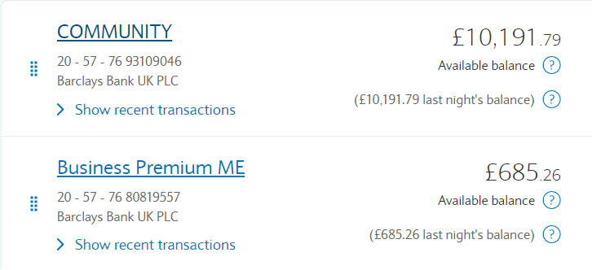
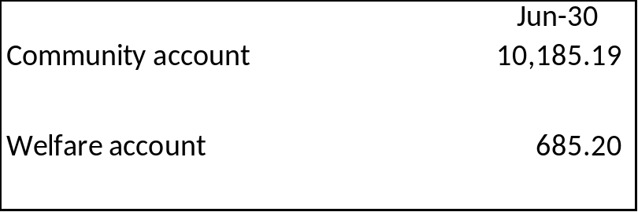
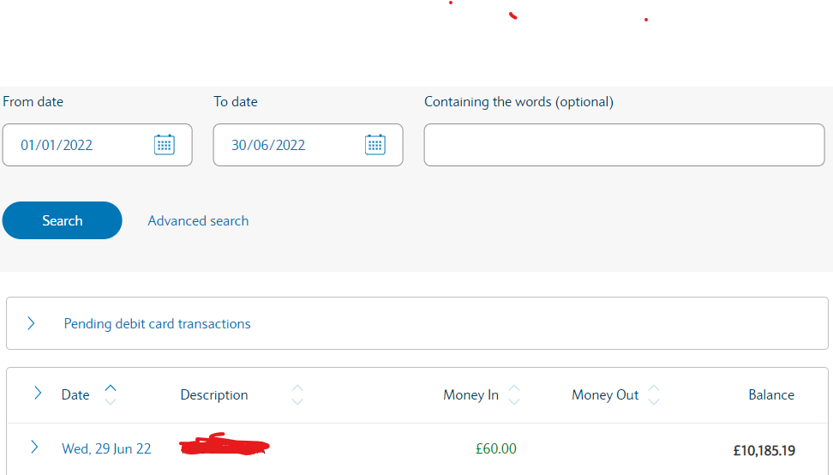

Slide 5
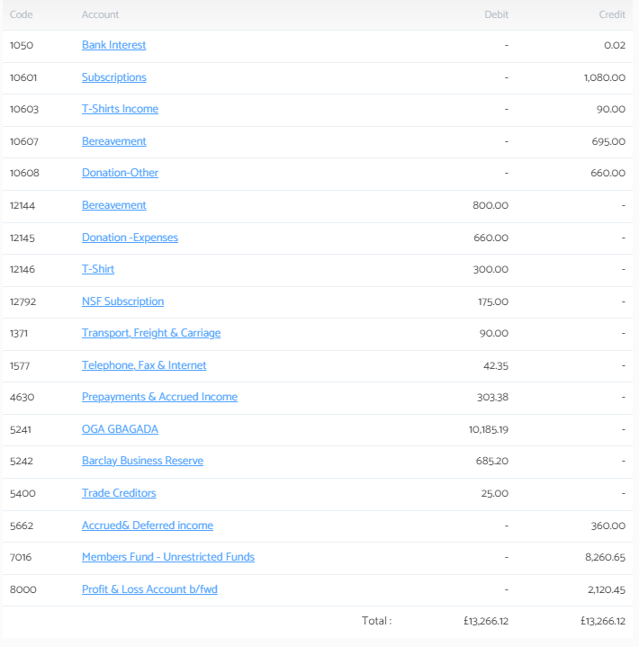
Appendix i –Trial Balance

Slide 6
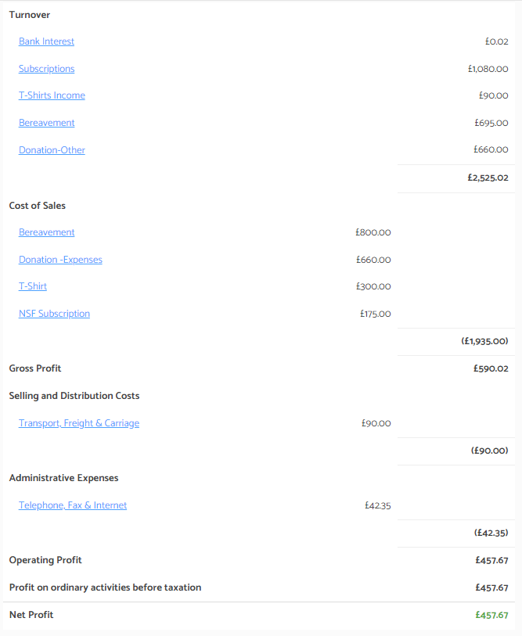
Appendix ii- Income & expenditure

Slide 7
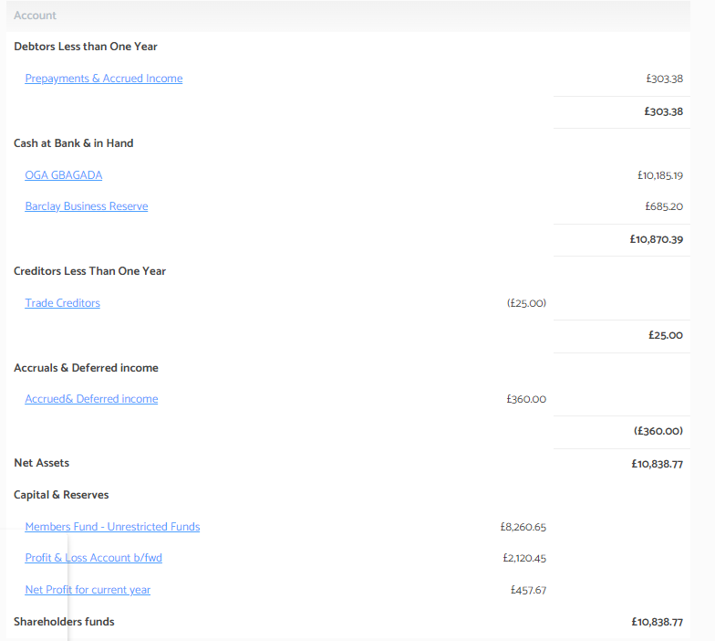
Appendix iii-Balance Sheet

Slide 8
Performance to date
Book delivery to Lagos
Student Empowerment
Sanitary Towel

Slide 9
Conclusion
Thank to you all to for your continued support and we look forward to working together in 2022.
For 2022 Subscription kindly make payment
OGA Gbagada
Barclays Banks
Sort- code – 20-57-76
Account Number - 93109046

Slide 10
Annual Subscription Remainder
2022 Annual Subscription is now overdue
Kindly make payment
OGA Gbagada
Barclays Banks
Sort- code – 20-57-76
Account Number - 93109046

